Slide 1
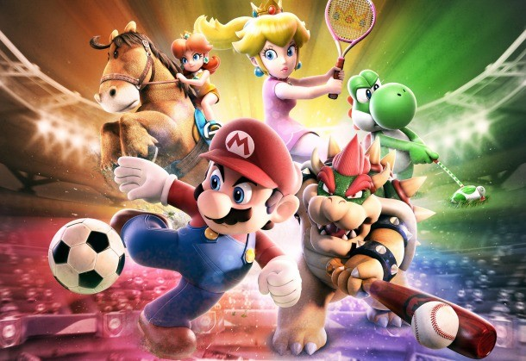
Sports Analytics III
Produced by Dr. Mario
UNC STOR 538

Slide 2
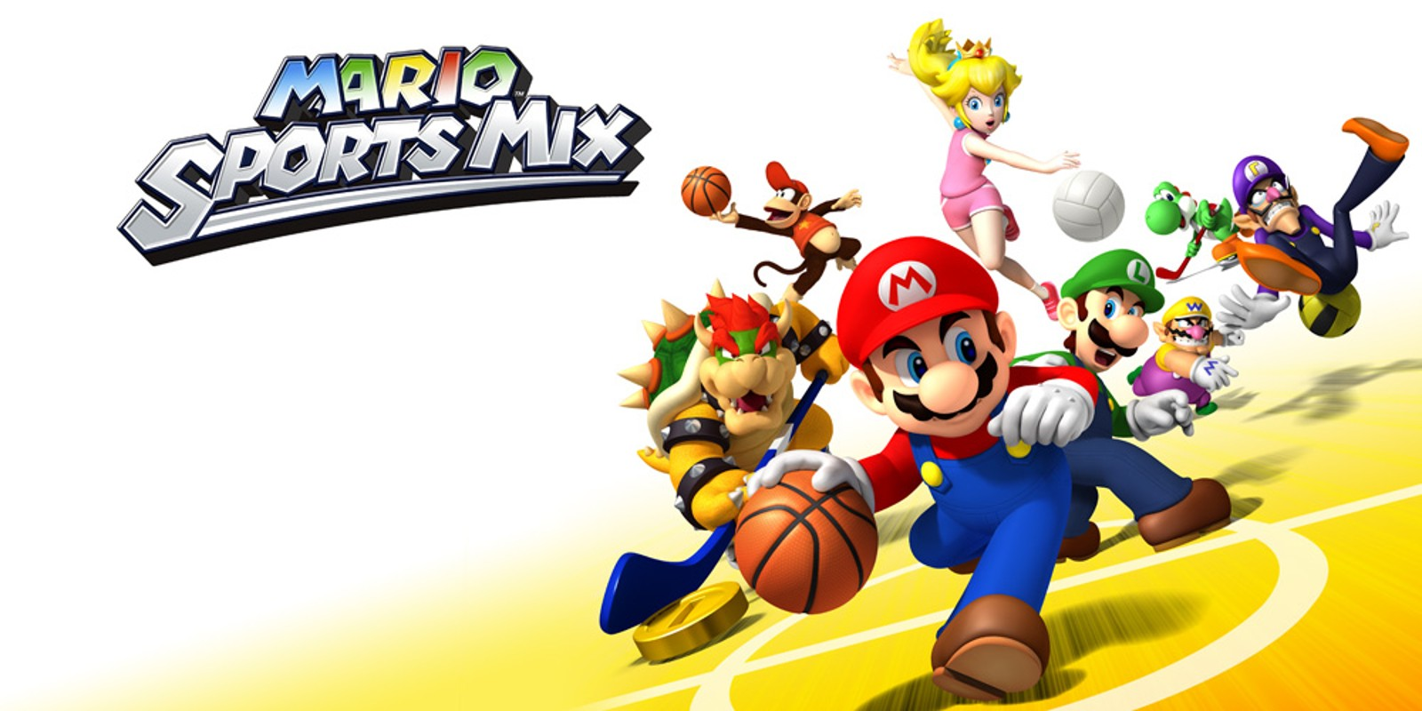
Industry Past
Sports Analytics Use Survey (2013)
Sample of 27 People (NFL, MLB, NBA, EPL)
How Many Different Sources?
1-2 (6.7%)
3-4 (33.3%)
5-6 (13.3%)
>6 (46.71%)

Slide 3
Industry Past
How Much Data is Centralized?
All (31.3%)
Most (37.4%)
Some (31.3%)
How Much Data is Dependent on One Person?
Some (50.0%)
Most (43.7%)
All Data Centralized (6.3%)

Slide 4
Industry Past
Is Data Checked for Errors?
Always (31.3%)
Usually (37.5%)
Sometimes (18.8%)
Occasionally (6.1%)
Rarely (6.3%)
How Many Database Programmers are Employed?
0 (37.5%)
1-2 (50.0%)
3-4 (0.0%)
>5 (12.5%)

Slide 5
Industry Past
How Many Statistical Analysts are Employed?
0 (20.0%)
1-2 (66.6%)
3-4 (0.0%)
>5 (13.3%)
Roadblock: Difficulty Identifying Strong Applicant
Difficulty in Both Hiring and Evaluating

Slide 6
Industry Past
Clear Process for Hiring/Evaluating Analysts
Strongly Agree (13.3%/14.3%)
Somewhat Agree (13.3%/14.3%)
Neutral (26.7%/28.6%)
Somewhat Disagree (13.4%/21.4%)
Strongly Disagree (33.3%/21.4%)
Analytic Resources in Line with Strategic Game Plan
Strongly Agree (26.7%)
Somewhat Agree (33.3%)
Neutral (33.3%)
Strongly Disagree (6.7%)

Slide 7
Industry Present
Value Placed on Sports Analytics
Global Sports Industry $486.61B (2022)
Expected CAGR over next 5 years is 5%
Global Sports Analytics Market in 2021 = $1.79B
Expected CAGR over next 8 years is 27.6%
$Projection in 2029=1.79∗(1+CAGR)^$8 =12.6
$12.6B
$1.79B
2021
2029
Projections in 2029 According to MarketWatch.com

Slide 8
Industry Present
Reasons for Projection (MarketWatch)
Focus on Data-Driven Decision Making
Demand for Fan Engagement
Growing Use of Analytics in Sports
Technological Advancements
Increasing Investment in Analytics

Slide 9
Industry Present
Upcoming Market Trends (MarketWatch)
Increased Use of AI and Machine Learning
Larger Emphasis on Data Visualization
More Comprehensive Data Collection
Increased Use of Data in Decision Making
Increased Demand in Sports Analytics Services
USA Companies in Market (MarketWatch.com)
Oracle
WHOOP
IBM
SAS
Stats Perform

Slide 10
Industry Present
Modern Applications of Sports Analytics
Helping the Team Win
Automated Video Analysis (Lincoln City, UK Football)
3D Depth Camera (NBA)
Wearable Technology (NBA, NHL)
Improving the Fan Experience
Analysis of Digital Engagement
Sentiment in Social Media
Analysis of Fan Behavior in Stadium (New England Patriots)
Wireless Internet and Phone Apps
Apps Supply Game Analytics, Parking Information, Promotions, and Traffic Information to the Fans (NFL)

Slide 11
Industry Present
Modern Applications of Sports Analytics
Benefiting Other Stakeholders
Tracking Fan Behavior Outside the Stadium
Telecommunication, Retailers, Payment Providers, Ticket Agencies, and Sponsorships
Adapt to Quick Changes in Consumer Behavior
Optimizing the Back-Office
HR Practices
Game Scheduling
Supply Chain Management and Logistics
Marketing and Promotions
Procurement of Goods and Services

Slide 12
Industry Present
Modern Applications of Sports Analytics
Advancing Sports Gambling
Supreme Court Ruling Previous Statute Violated 10th Amendment (Murphy v. National Collegiate Athletic Association)
States Free to Legislate Gambling
Improvement of Gambling Products
Data Aggregation and Visualization for Bettors
Develop Daily Fantasy Sports
Business Research Company
Market grew from $96.84B to 104.78B in Last Year
Largest Market is Western Europe

Slide 13
Your Industry Future
Prerequisites by Howard Hamilton
(Soccermetrics)
Technical Skills
Mathematics (Linear Algebra/Probability Essential)
Statistics (Frequentist and Bayesian Perspectives)
Machine Learning (Supervised and Unsupervised)
Programming (R/Python, Data Structures, OOP)
Databases
Visualization
Socials Skills, Ethics, and the Law
Knowledgeable About All Aspects of the Sport

Slide 14
Your Industry Future
Real Jobs (Indeed)
Data Engineer, Sports Analytics for SIG
Data Science in Python
Large Data Storage and Data Processing
PhD, Master’s, or Bachelor’s
Newest Business Area
Sports Scientist, Chicago Women’s Soccer Academy
Bachelor’s or Master’s in Exercise Science
Experience with Sports Science Technologies
Deliver Daily Reports and Provide Data-Driven Feedback

Slide 15
Your Industry Future
Real Jobs (Indeed)
Sports Performance Analyst, Baltimore Orioles
Primarily Data Management/ Organization
Requirements are Unknown
Sports Injury Data Scientist, RWE Agile Analytics
Part of IQVIA
SQL, Python, SAS, R
Familiar with Basic Statistical Analyses
Bachelor’s (6-8 years experience)
Master’s (3-5 years experience)

Slide 16
Your Industry Future
Real Jobs (Indeed)
Sports Science Coordinator, Houston Texans
Master’s Required
Expected to Constantly Learn
MS in Sport Performance
SQL, Statistics, R/Python
Machine Learning and Time Series Methods
Professor of Data Analytics, University of Tulsa
Focus on Sports Analytics
PhD and Research Background in Sports
College of Business

Slide 17
Your Industry Future
Real Jobs (Indeed)
Analyst, Club Business Operations for MLB
Quantitative Market Analyses
BS Degree in Business Related Field
Excel, PowerPoint, SQL
Exceptional Data Evaluation Skills
Business Analyst, Sports & Entertainment for Aramark
Hospitality Company for Many Industries
Data Visualization with Tableau or PowerBI
Exposure to Some Programming Language

Slide 18
Your Industry Future
Real Jobs (Indeed)
Analyst, Baseball Operations for Giants
Perform Statistical Analyses
Collaboration with Software Engineers
BS in Quantitative Field
R, SQL, Python
Director of Data Science, DICK’S Sporting Goods
MS in Stats, Math, Econ, etc.
10-15 Years Experience
Proficient in SQL, R, Python, or SAS
Cloud Computing Environments
Lead Team of Data Science Managers and Data Scientists

Slide 19
Your Industry Future
Conferences
Carnegie Mellon Sports Analytics Conference
Great Lakes Analytics Conference
MathSport International
MIT Sloan Sports Analytics Conference
New England Symposium on Statistics in Sports
Rochester Institute of Technology Sports Analytics Conference
Sports IDEAS Symposium
Uconn Sports Analytics Symposium
Compiled on Medium.com

Slide 20
Final Inspiration
Defense wins championships.
Offense wins contracts.
Be offensive.
- Mahatma Mario

